Slide 1



RAM: Radar-based Activity Monitor
IEEE INFOCOM’16
April 12th, 2016
Md Abdullah Al Hafiz Khan, Ruthvik Kukkapalli, Piyush Waradpande,
Sekar Kulandaivel, Nilanjan Banerjee, Nirmalya Roy, Ryan Robucci

Slide 2



Assistive Elderly Care Application

Slide 3



Occupancy Counting Application
3 persons
2 persons

Slide 4
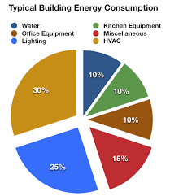
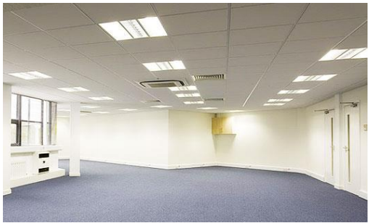
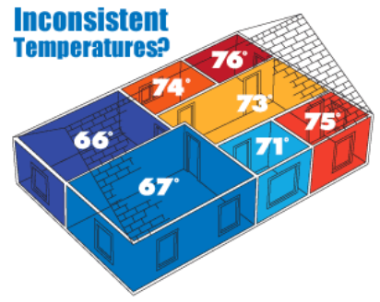
Building Energy Management

Slide 5
Solutions?
Activity Detection!
How to Help Elder Individual?
Recommendation System for Alzheimer’s Individual
Which class is interactive?
Check how many student ask questions
How to manage building energy?
Check human activity pattern to optimize energy usage
Radar Sensor + Server side processing

Slide 6
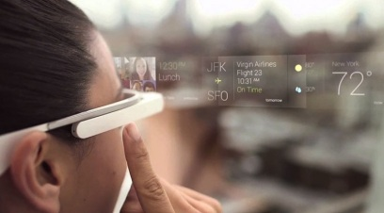
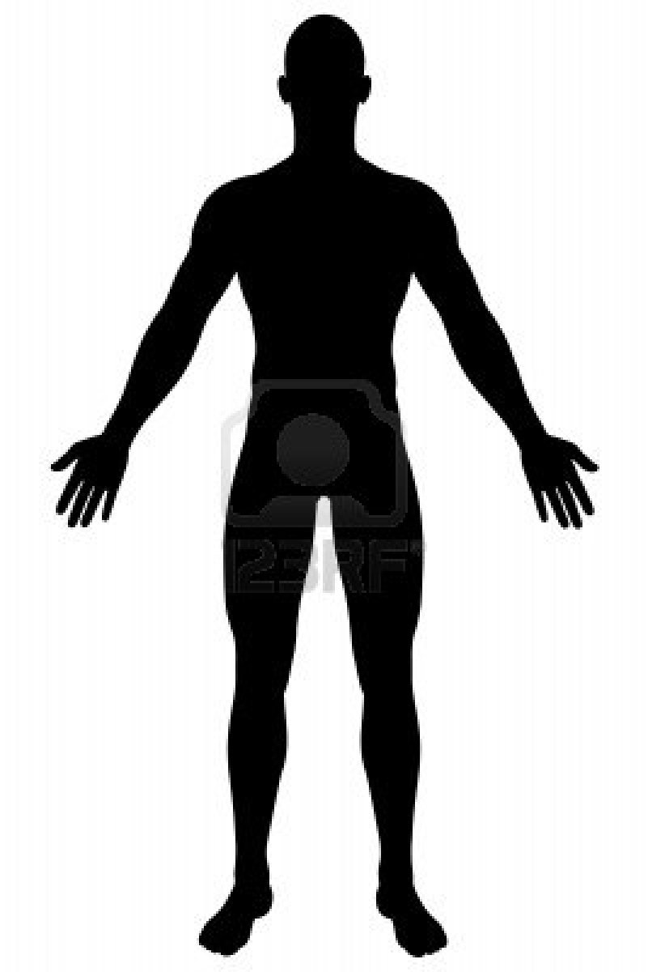
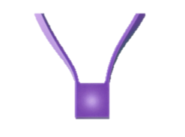
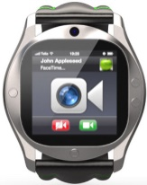
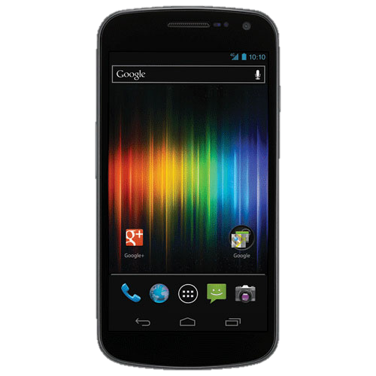
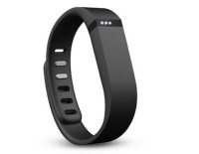
Ubiquitous Wearable Sensing
Glass
Necklace
Watch
Brace
Phone
6

Slide 7
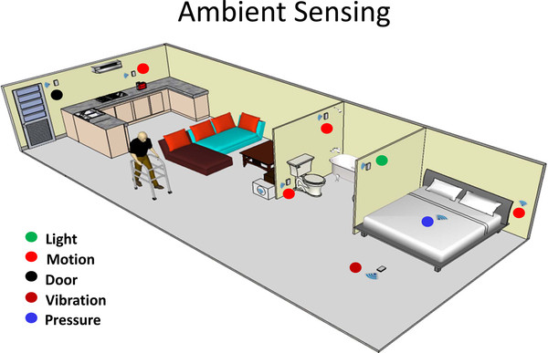
Ambient Sensing
Notes:
Using light, motion sensor researcher determines Coarse-grained activities - i.e. walking, running
Fine grained activities - i.e. bathroom activities can be inferred by more deep investigation?

Slide 8
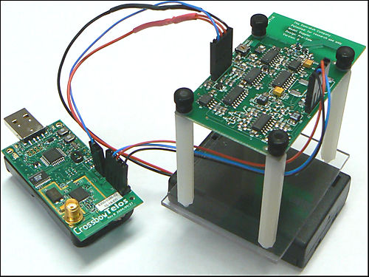
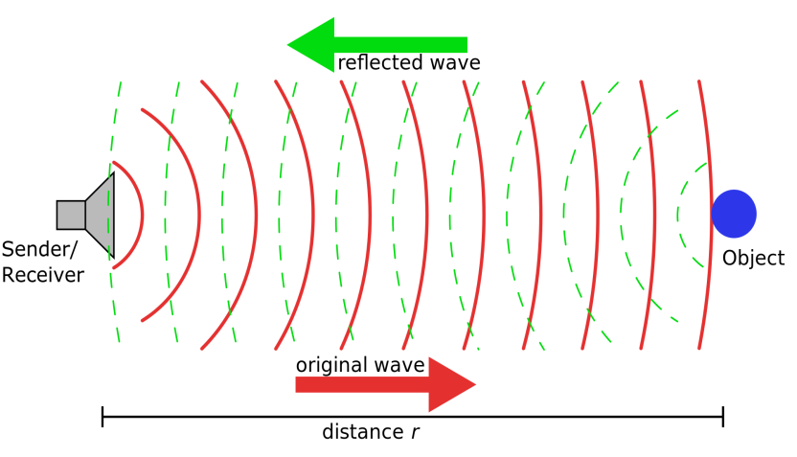
Which sensor ?
Pulse Doppler Radar
Bumble Bee Radar
Next thing:
How to sense activity?

Slide 9




Activities

Slide 10
How to Detect Activities?
Challenge
Sense human body movement
Background noise
Multiple Radars data
Signal Processing
software & Hardware

Slide 11
How to Detect Activities?
Challenge | Solution
Sense human body movement | Array of micro-Doppler radars
Background noise | Frequency-based filter
Multiple Radars data | Data fusion
Signal Processing | Software Stack
software & Hardware | Functional Prototype

Slide 12
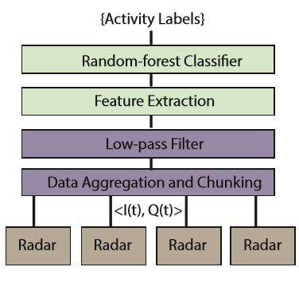
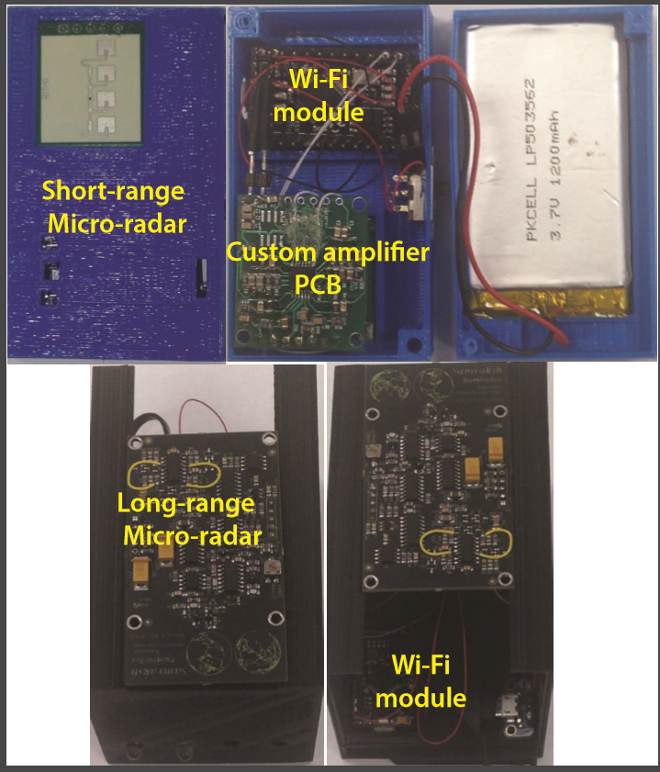
Overview of RAM
Hardware Architecture
Software Stack

Slide 13
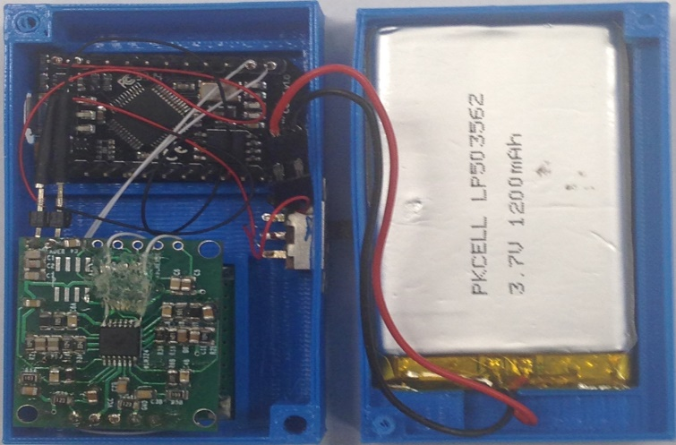
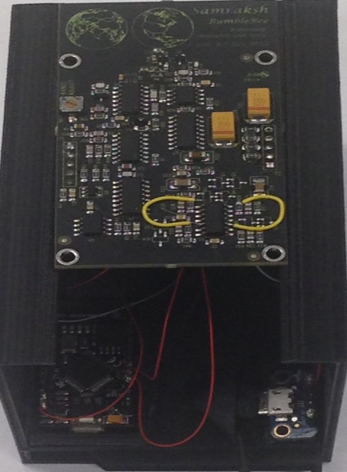
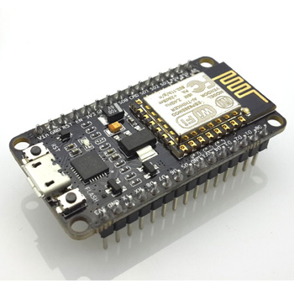
Hardware Architecture
Hardware Architecture
RFBeam KLC-2
Spark Core
BumbleBee
Notes:
{Bumblebee pulse doppler radar:} - range 10m, Conical coverage 60 degree, Operates at 5.8-GHz.
{RFBeam KLC-2:} - short range, Conical coverage $30\si{\degree}$, Operates at 25-GHz.
{Spark Core:} Texas Instruments CC3000 radio and STM32F103 72-MHz ARM Cortex M3 Processor. Voltage range 3.6 to 6V.

Slide 14
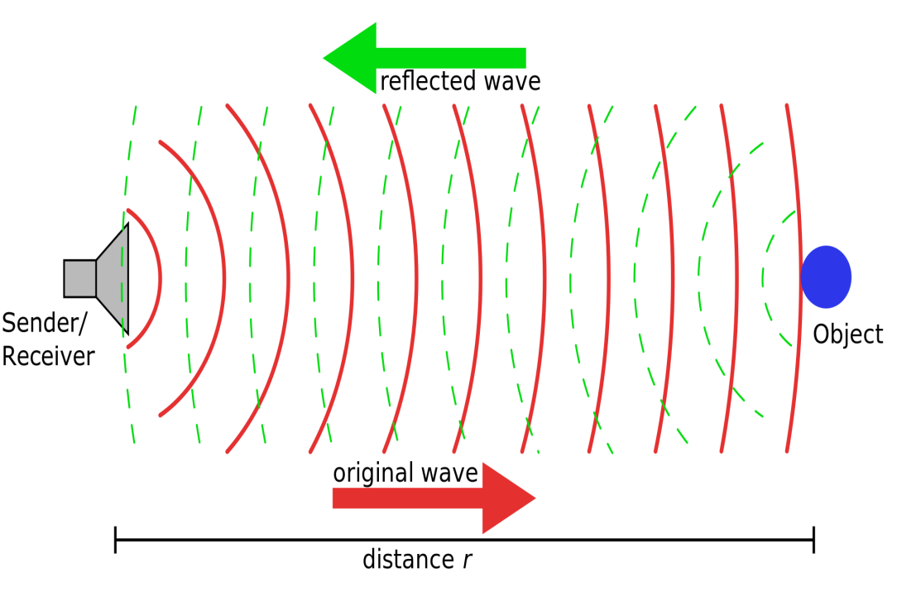
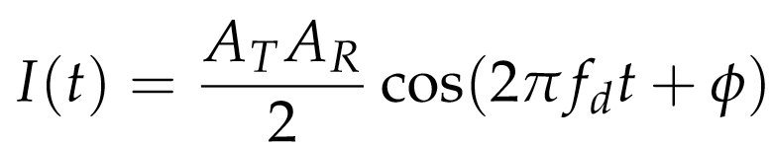
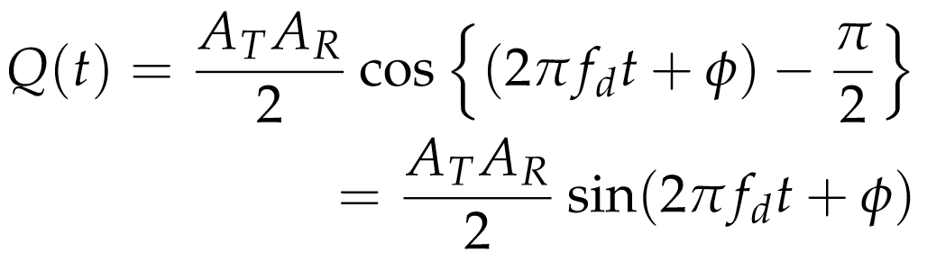
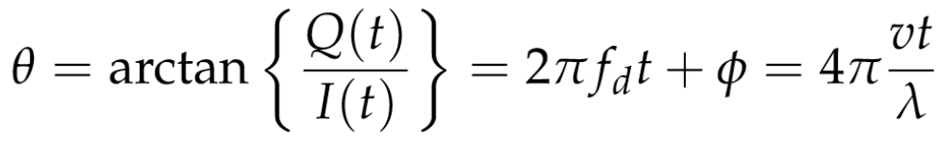
Representing Radar Signals
Phase:

Slide 15
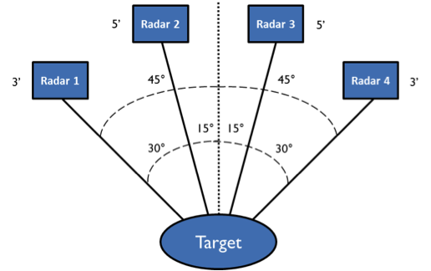
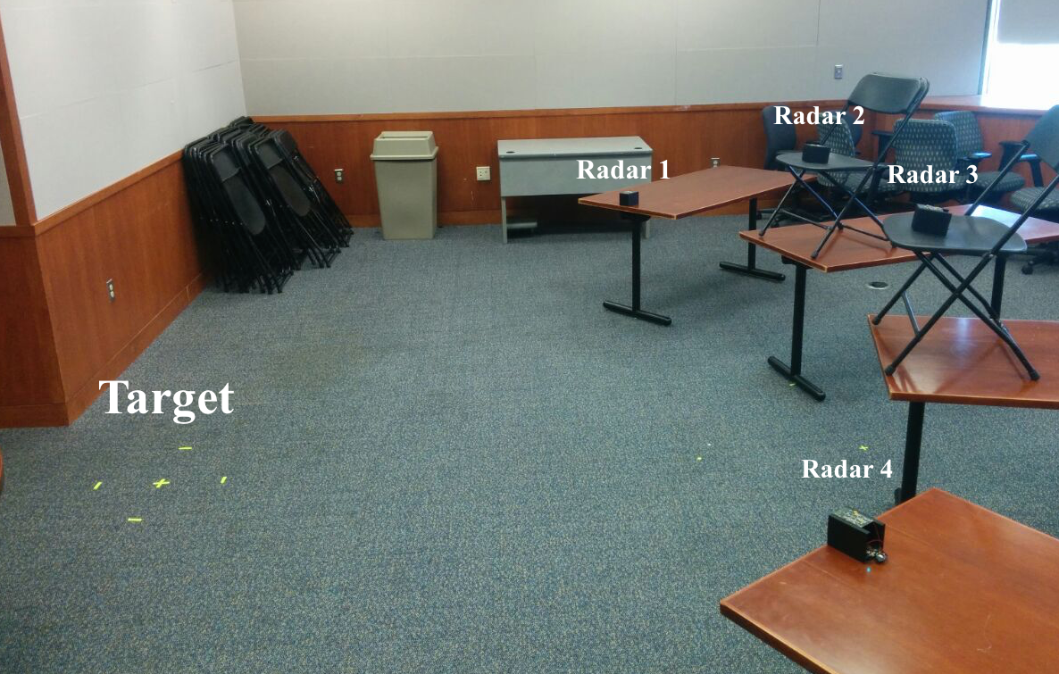
Capturing Fine-grained Human Body Movements
Sample Testbed
Position of Radars
Notes:
Recruits 5 subjects, age group of 18 to 50 years.
RAM placed at approximately 3m from the subjects.
Radars are placed in front of the subjects.
Two radar placed at 15 degree and other two 45 degree with respects to the subjects.
Radars places at waist height level and eye-level.
Sampling frequency was 200 Hz.

Slide 16
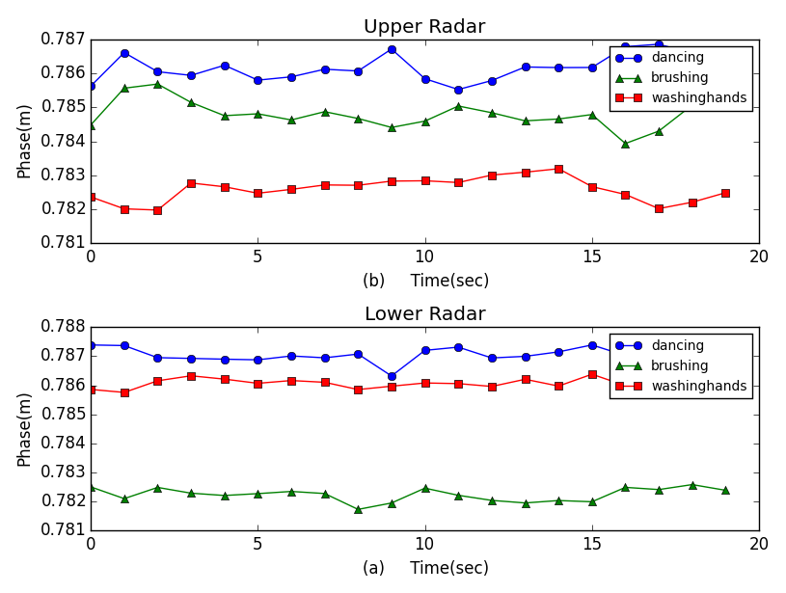
Determining Differences in Activities
Differences?
Notes:
Short range radar shows higher accuracy at short distances.
Bumblebee long-range radar has a higher accuracy at long distance.

Slide 17
Single RAM Setup
Cleaning Activity
(Precision)
Radar 1 | Radar 2
91.3 | 60.87
Capture fine-grained movement?
Focus Specific portion of body?
Notes:
How data was processed?
How to detect activities?
What are the significance?
Cleaning – wiping and spraying combination
RAM process individual radars data and classify them separately.
Average classification accuracy was 78.95% for bathroom activities and 77.17% for cleaning activities.

Slide 18
Homogeneous Data Fusion with multiple Radars at different positions
Cleaning Activity
(Precision)
Fusion1 Radar (1 + 2) | Radar 2
88.3 | 84.04
Improved! Why?
Capture Different Position body movement?
Notes:
How data was processed?
How to detect activities?
What are the significance?
Cleaning – wiping and spraying combination
RAM process individual radars data and classify them separately.
Average classification accuracy was 78.95% for bathroom activities and 77.17% for cleaning activities.

Slide 19
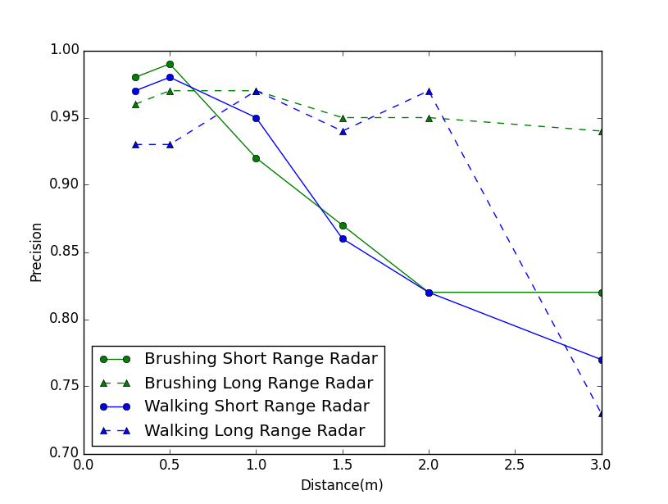
Heterogeneous Data Fusion with multiple Radars at different positions
Long Range radar
Data Fusion
Short Range radar
Precision | Recall | Activities
0.76 | 0.61 | Entertainment
0.58 | 0.49 | Cooking
Required radar placement Strategy
Notes:
Table III shows results for the FMR-DT setup. The experiments were performed when the subject was at a distance of 1m from two radars (short-range and longrange). The table shows that combining these two radars does not provide high classiﬁcation accuracy for most activities. In fact, it is worth noting (see Figure 3) that these radars individually perform well for activity recognition depending on the distance between the human and the radar. The results shows that the radars must be strategically placed depending on the size of the room. For example, in bathrooms that are smaller in size, the short-range radar must be used while the living area an array of Bumblebee radars are likely to perform better

Slide 20
Conclusion
RAM - a non-intrusive low-cost heterogeneous ambient radar sensor system.
Radars must be placed strategically to detect ADLs.
Implemented and evaluated in real setting.
RAM achieved 90% accuracy.

Slide 21
Thank you

